Slide 1
Automatic Brake System using Fuzzy Logic

Slide 2
Overview
Human judgment error may cause serious accidents due to inaccurate reaction time and time consumes to perform full braking. In many such cases, the main cause of such accidents is the distraction through driving and failure to react in such enough time.
Therefore, auto brake system in vehicle will utilize both its speed sensor which measures the wheel speed and distance sensor which is based on ultrasonic waves to compute the safety distance between the vehicle and its neighbours by controlling the brake pressure force on the brake pedal.

Slide 3
In this project, we design human free brake system that maintains both the vehicle speed and inter-vehicle distance, to automatically decelerate the vehicle on urgent demands by controlling the brake force pressure.

Slide 4
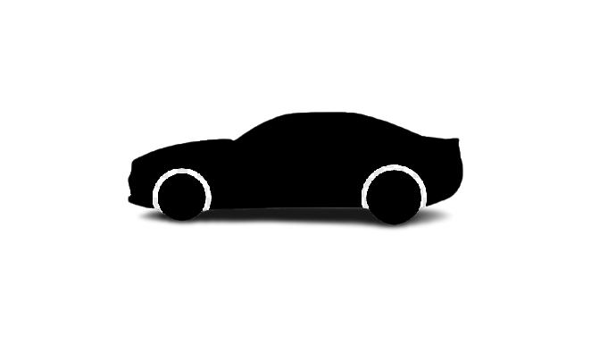
Fuzzy controller-based vehicale
Neighbour vehicale
Distance = d m
Simplified explanation of our proposed fuzzy controller

Slide 5
INPUT-OUTPUT OF FUZZY LOGIC SYSTEM
2 inputs
1 output
the inter-distance is based on ultra-sonic sensor
speed is based on speed sensor
The output of our fuzzy proposed controller is brake force pressure

Slide 6
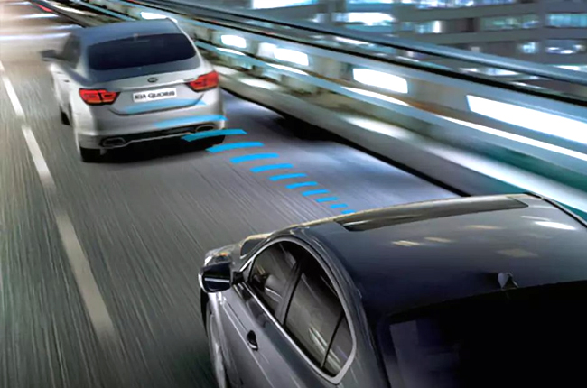
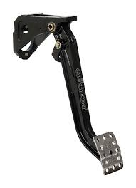
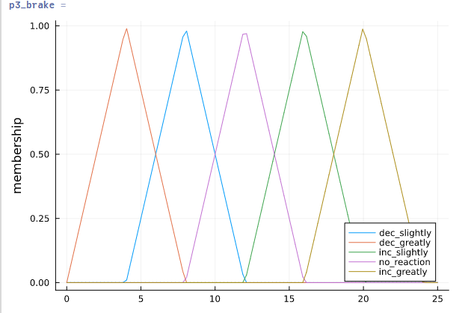
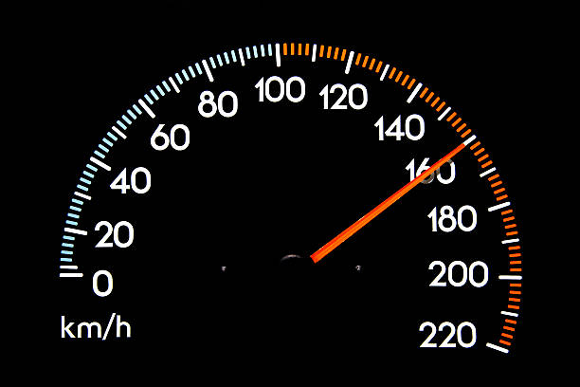
DESIGN STRUCTURE
DISTANCE
INFERENCE ENGINE
MAMDANI
CAR SPEED
BRAKE FORCE AMOUNT DEFUZZIFICATION
(CENTROID)

Slide 7
Fuzzification
We divide the distance range from 0-10 m to three sub ranges, too close(too close), close, and far.
The inter-vehicle distance is classified as follows:
Very close distance (0-4 m), Triangular.
Close distance (2-8 m), Triangular.
Far distance (6-10 m), Triangular.

Slide 8
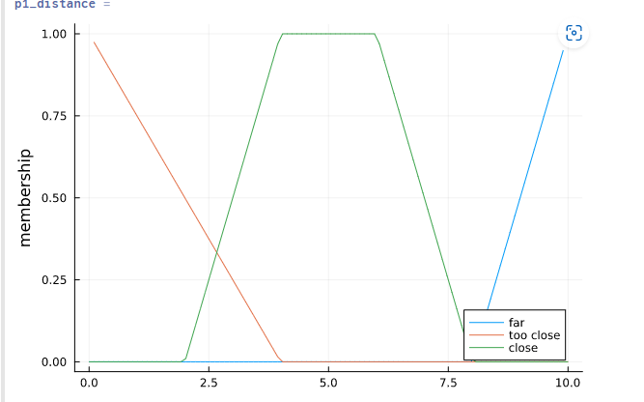
Membership function of inter-vehicale distance

Slide 9
We divide the vehicle speed from 0 to 25 m/s to 5 different ranges as follows:
Too slow (0-4 m/s), Trapezoidal.
Slow (3-9 m/s), Trapezoidal.
Optimum (8-14 m/s), Trapezoidal.
Fast (13-19 m/s), Trapezoidal.
Too Fast (18-24 m/s), Trapezoidal.

Slide 10
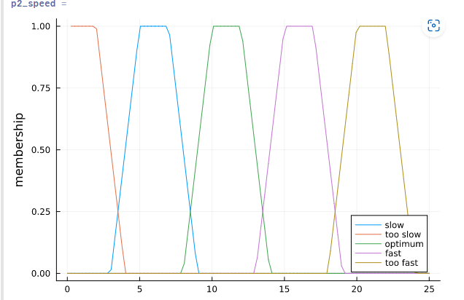
Membership function of speed

Slide 11
The output of our fuzzy system is the amount of brake force and is classified as follows:
Decrease brake force greatly (0-8 N)
Decrease brake force slightly (4-12 N)
No brake reaction (8-16 N)
Increase brake force slightly (12-20 N)
Increase brake force greatly (16 -24 N)

Slide 12
Membership function of brake_force_amount

Slide 13
Rule Base & Inference Engine
If too close, Then increase greatly.
If close and too fast, Then increase slightly.
If close and optimum, Then increase slightly.
If far and optimum, Then no reaction.
If far and slow, Then slightly decrease.
If far or too slow, Then greatly decrease.

Slide 14
Defuzzification
We used Mamadni inference engine which is the simplest one and to extract the crisp output we used a centroid method.

Slide 15
Julia code using Pluto.jl

